Slide 1
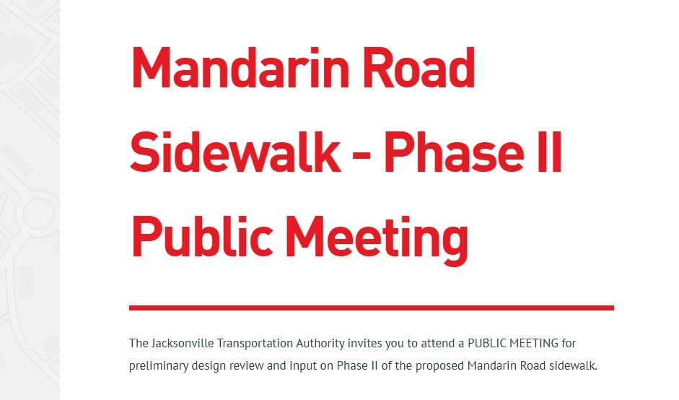

Slide 2
This Evening’s Agenda
  REVIEW OF ORDINANCE 2001-1009
  OVERVIEW OF THE COMPLETE STREETS 2016 RECOMMENDATIONS & PLAN
  MANDARIN SIDEWALK – FIRST PHASE
  JONATHAN COLBURN – URBAN FORESTER (COJ)
  ANDY RODGERS – PROJECT MANAGER (JTA)
  PLAN REVIEW – (BREAKOUT SESSION)
  PUBLIC COMMENT

Slide 3
ORDINANCE 2001-1009-E

Slide 4
ORDINANCE 2001-1009-E
Protected tree status for any live oak with a caliper of six inches or more within twenty feet of right-of-way.
Comment from PWD’s Urban Forester and City Council member prior to issue of permit for removal or relocation.
Marking of stakes of newly-planted trees
Pruning of trees within right-of-way around power lines to comply with policy standards
Notification to PWD’s Urban Forester re installation of underground utilities and CM advised of recommendations.
Underground installation of powerlines by JEA where feasible.
Repaving of the streets to be maintained at existing width.

Slide 5
2016 JTA Mobility Works Complete Streets Report
Corridor Overview
The primary deficiency of Mandarin Road and Plummer Cove Road is
the lack of pedestrian accommodations. The corridor segments lacking
sidewalk serve approximately 1,400 homes which have direct or indirect
access via a dead-end or neighborhood roads. In addition to the high
number of homes, two noteworthy recreational destinations are located at
the north and south ends of Mandarin Road – Walter Jones Historical Park
and Mandarin Park. In addition, Brady Park/Alberts Field, which draws
significant activity, with tennis and ball fields, is located between Mandarin
Road and Orange Picker Road.

Slide 6
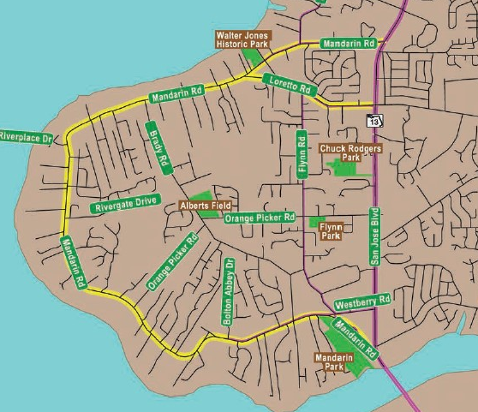

Slide 7
2016 JTA Mobility Works Complete Streets Report
Corridor Overview
The primary deficiency of Mandarin Road and Plummer Cove Road is
the lack of pedestrian accommodations. The corridor segments lacking
sidewalk serve approximately 1,400 homes which have direct or indirect
access via a dead-end or neighborhood roads. In addition to the high
number of homes, two noteworthy recreational destinations are located at
the north and south ends of Mandarin Road – Walter Jones Historical Park
and Mandarin Park. In addition, Brady Park/Alberts Field, which draws
significant activity, with tennis and ball fields, is located between Mandarin
Road and Orange Picker Road.

Slide 8
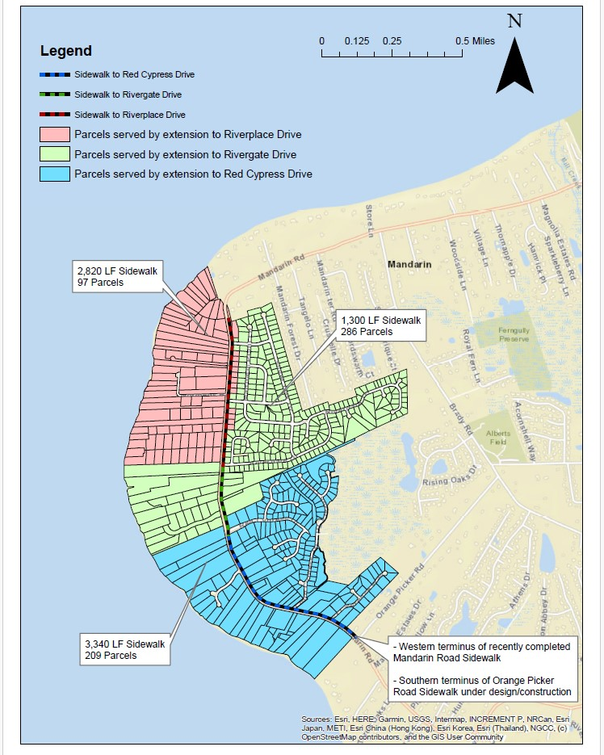

Slide 9
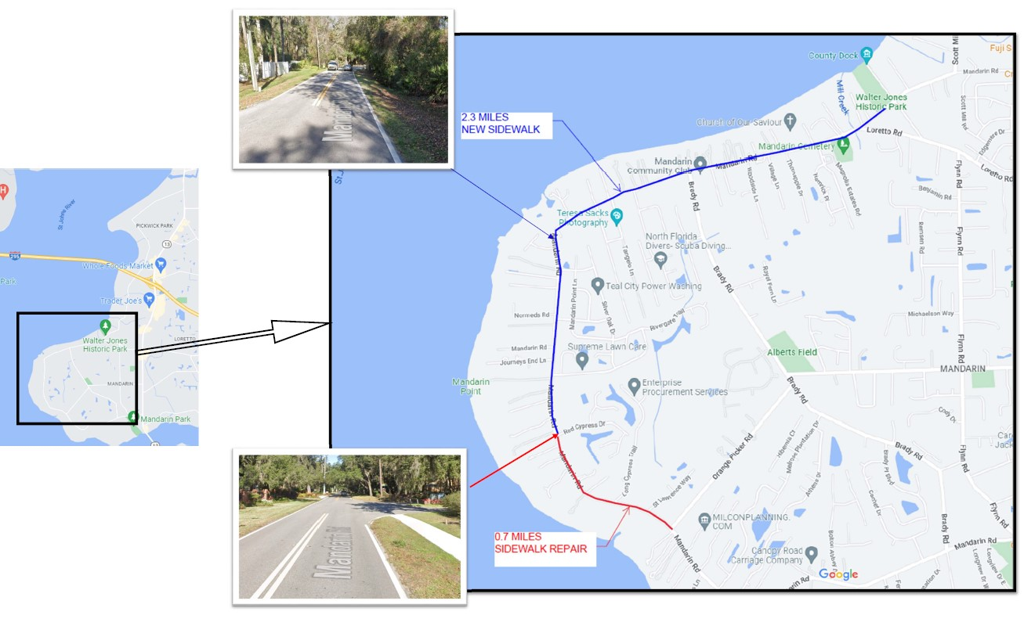

Slide 10


Slide 11
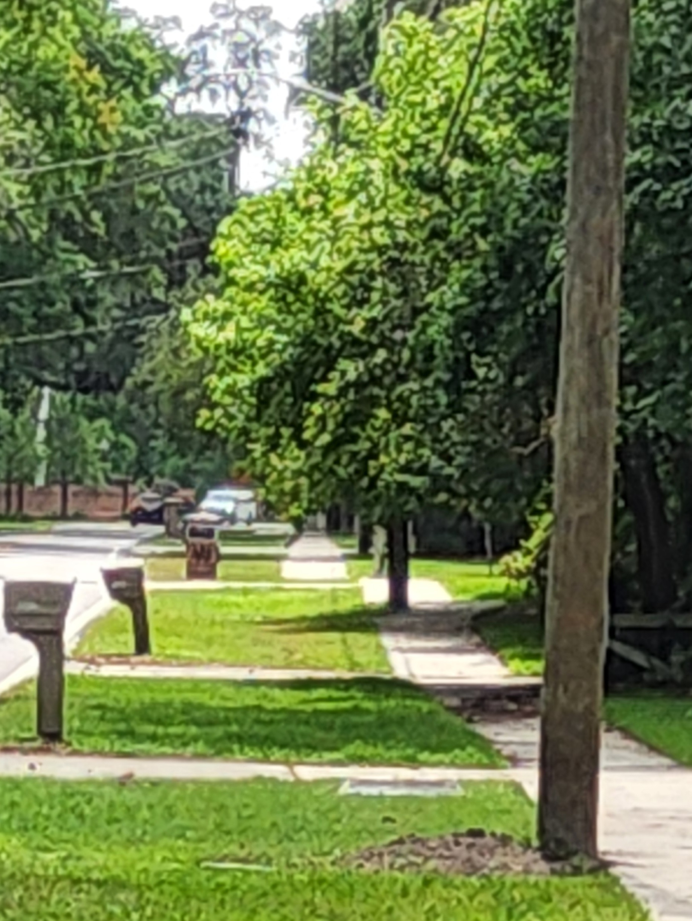
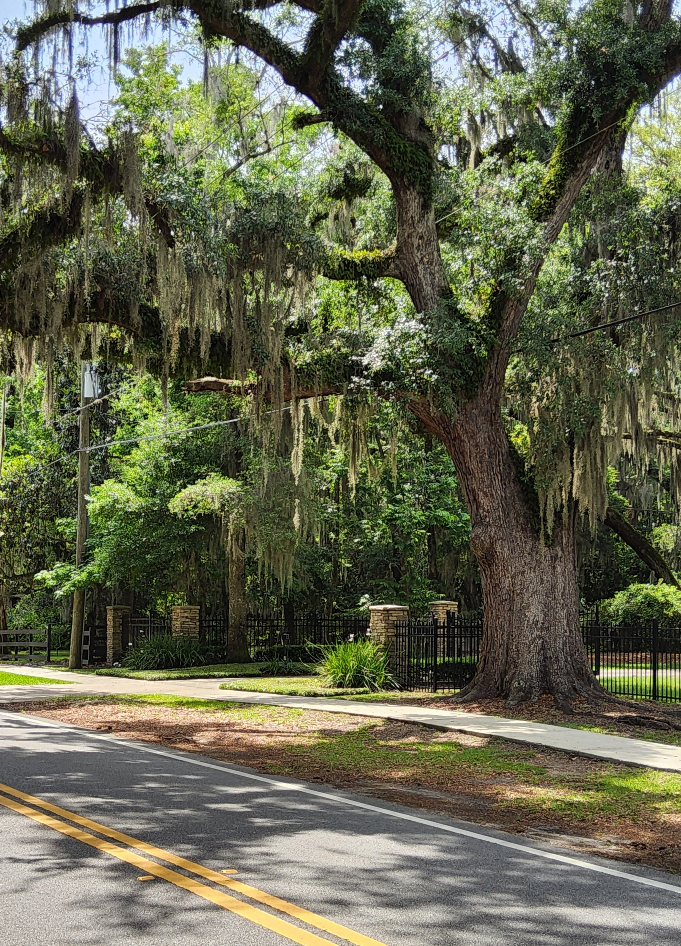
BRADY PLACE BLVD.
REGGIE ROAD

Slide 12
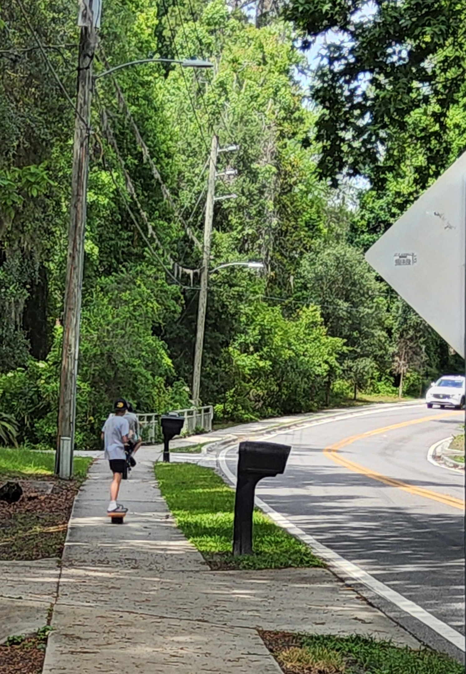
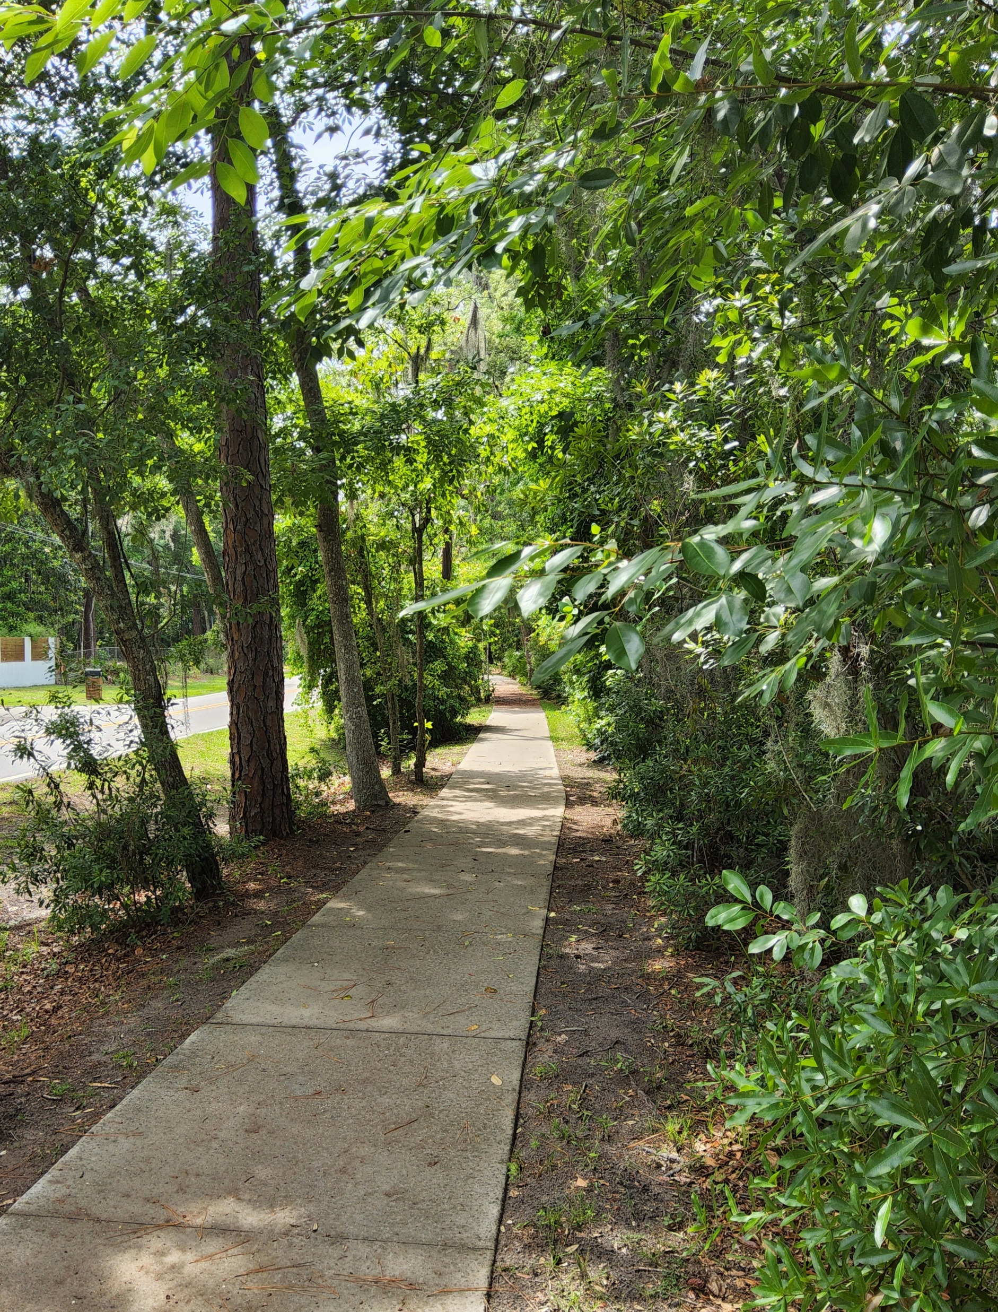
BLANCHE ROAD
ST. LAWRENCE ROAD

Slide 13
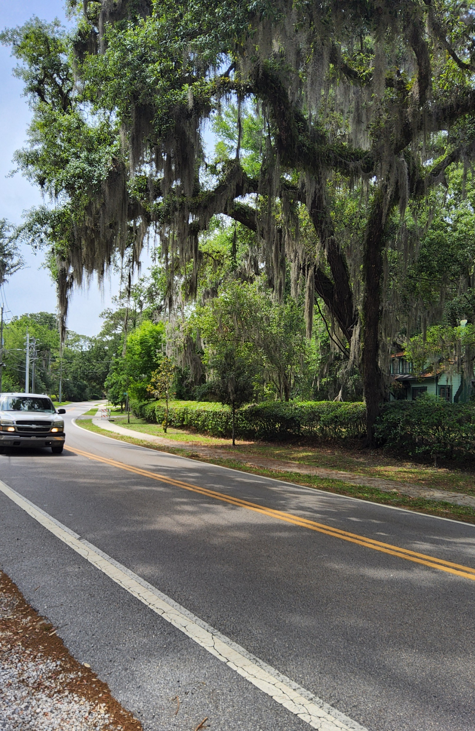
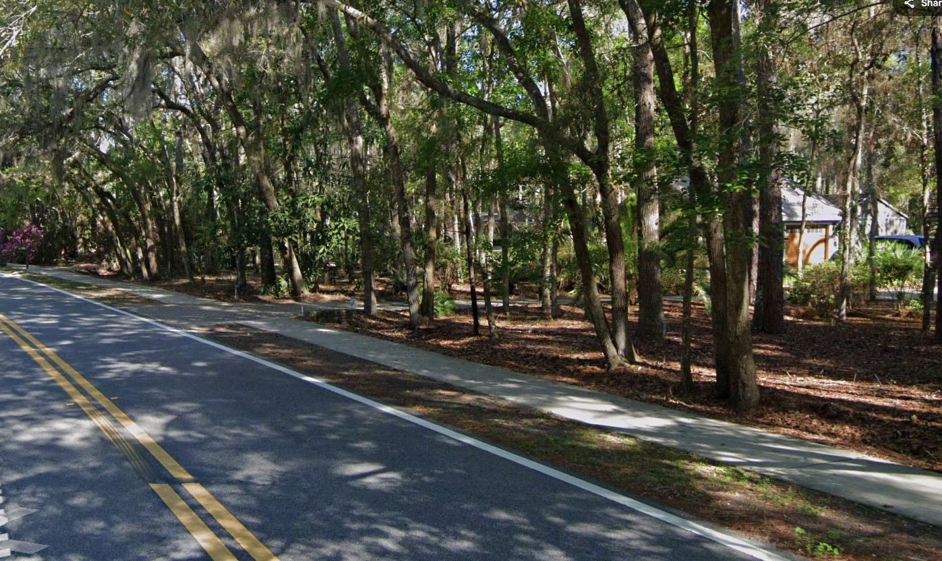
ORANGE PICKER ROAD
MANDARIN OAKS LANE

Slide 14
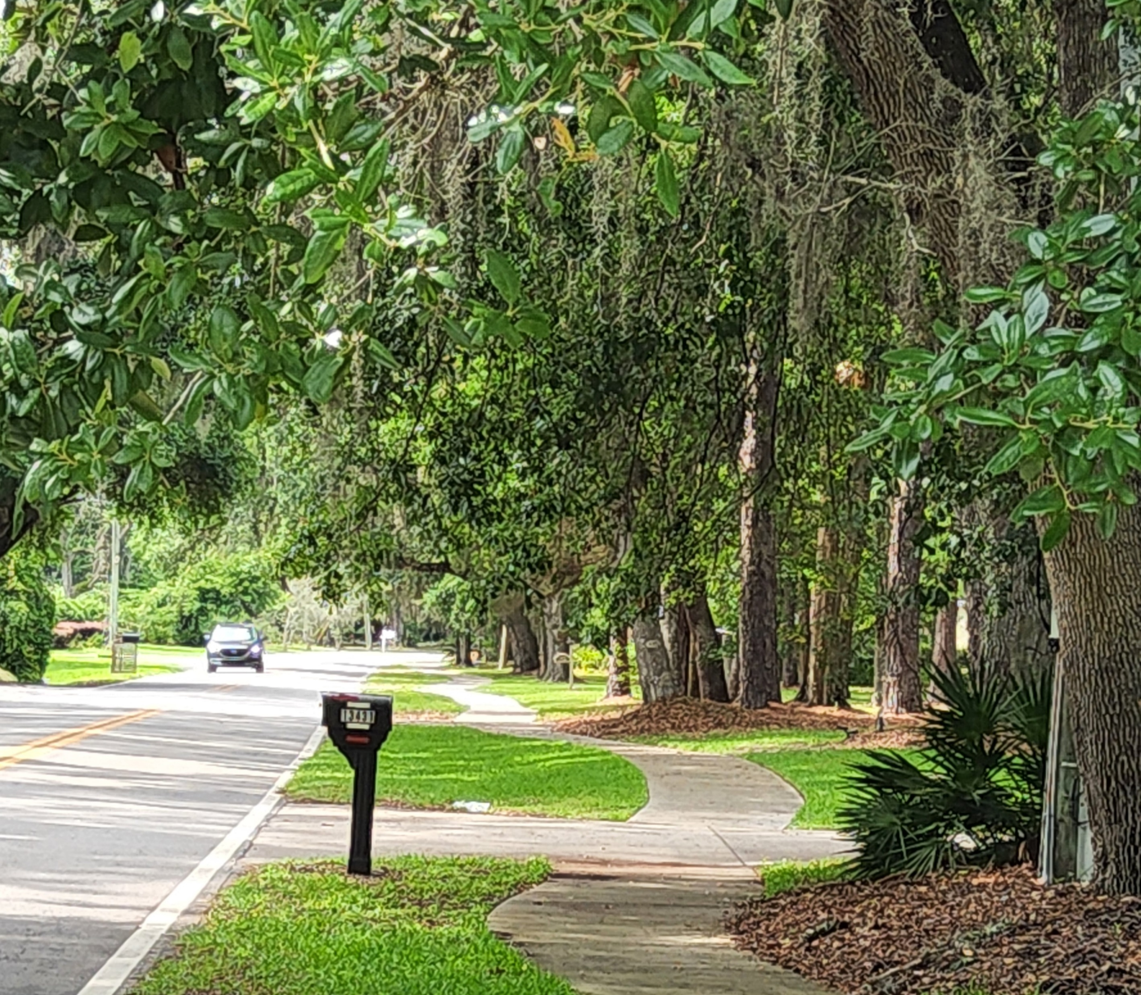
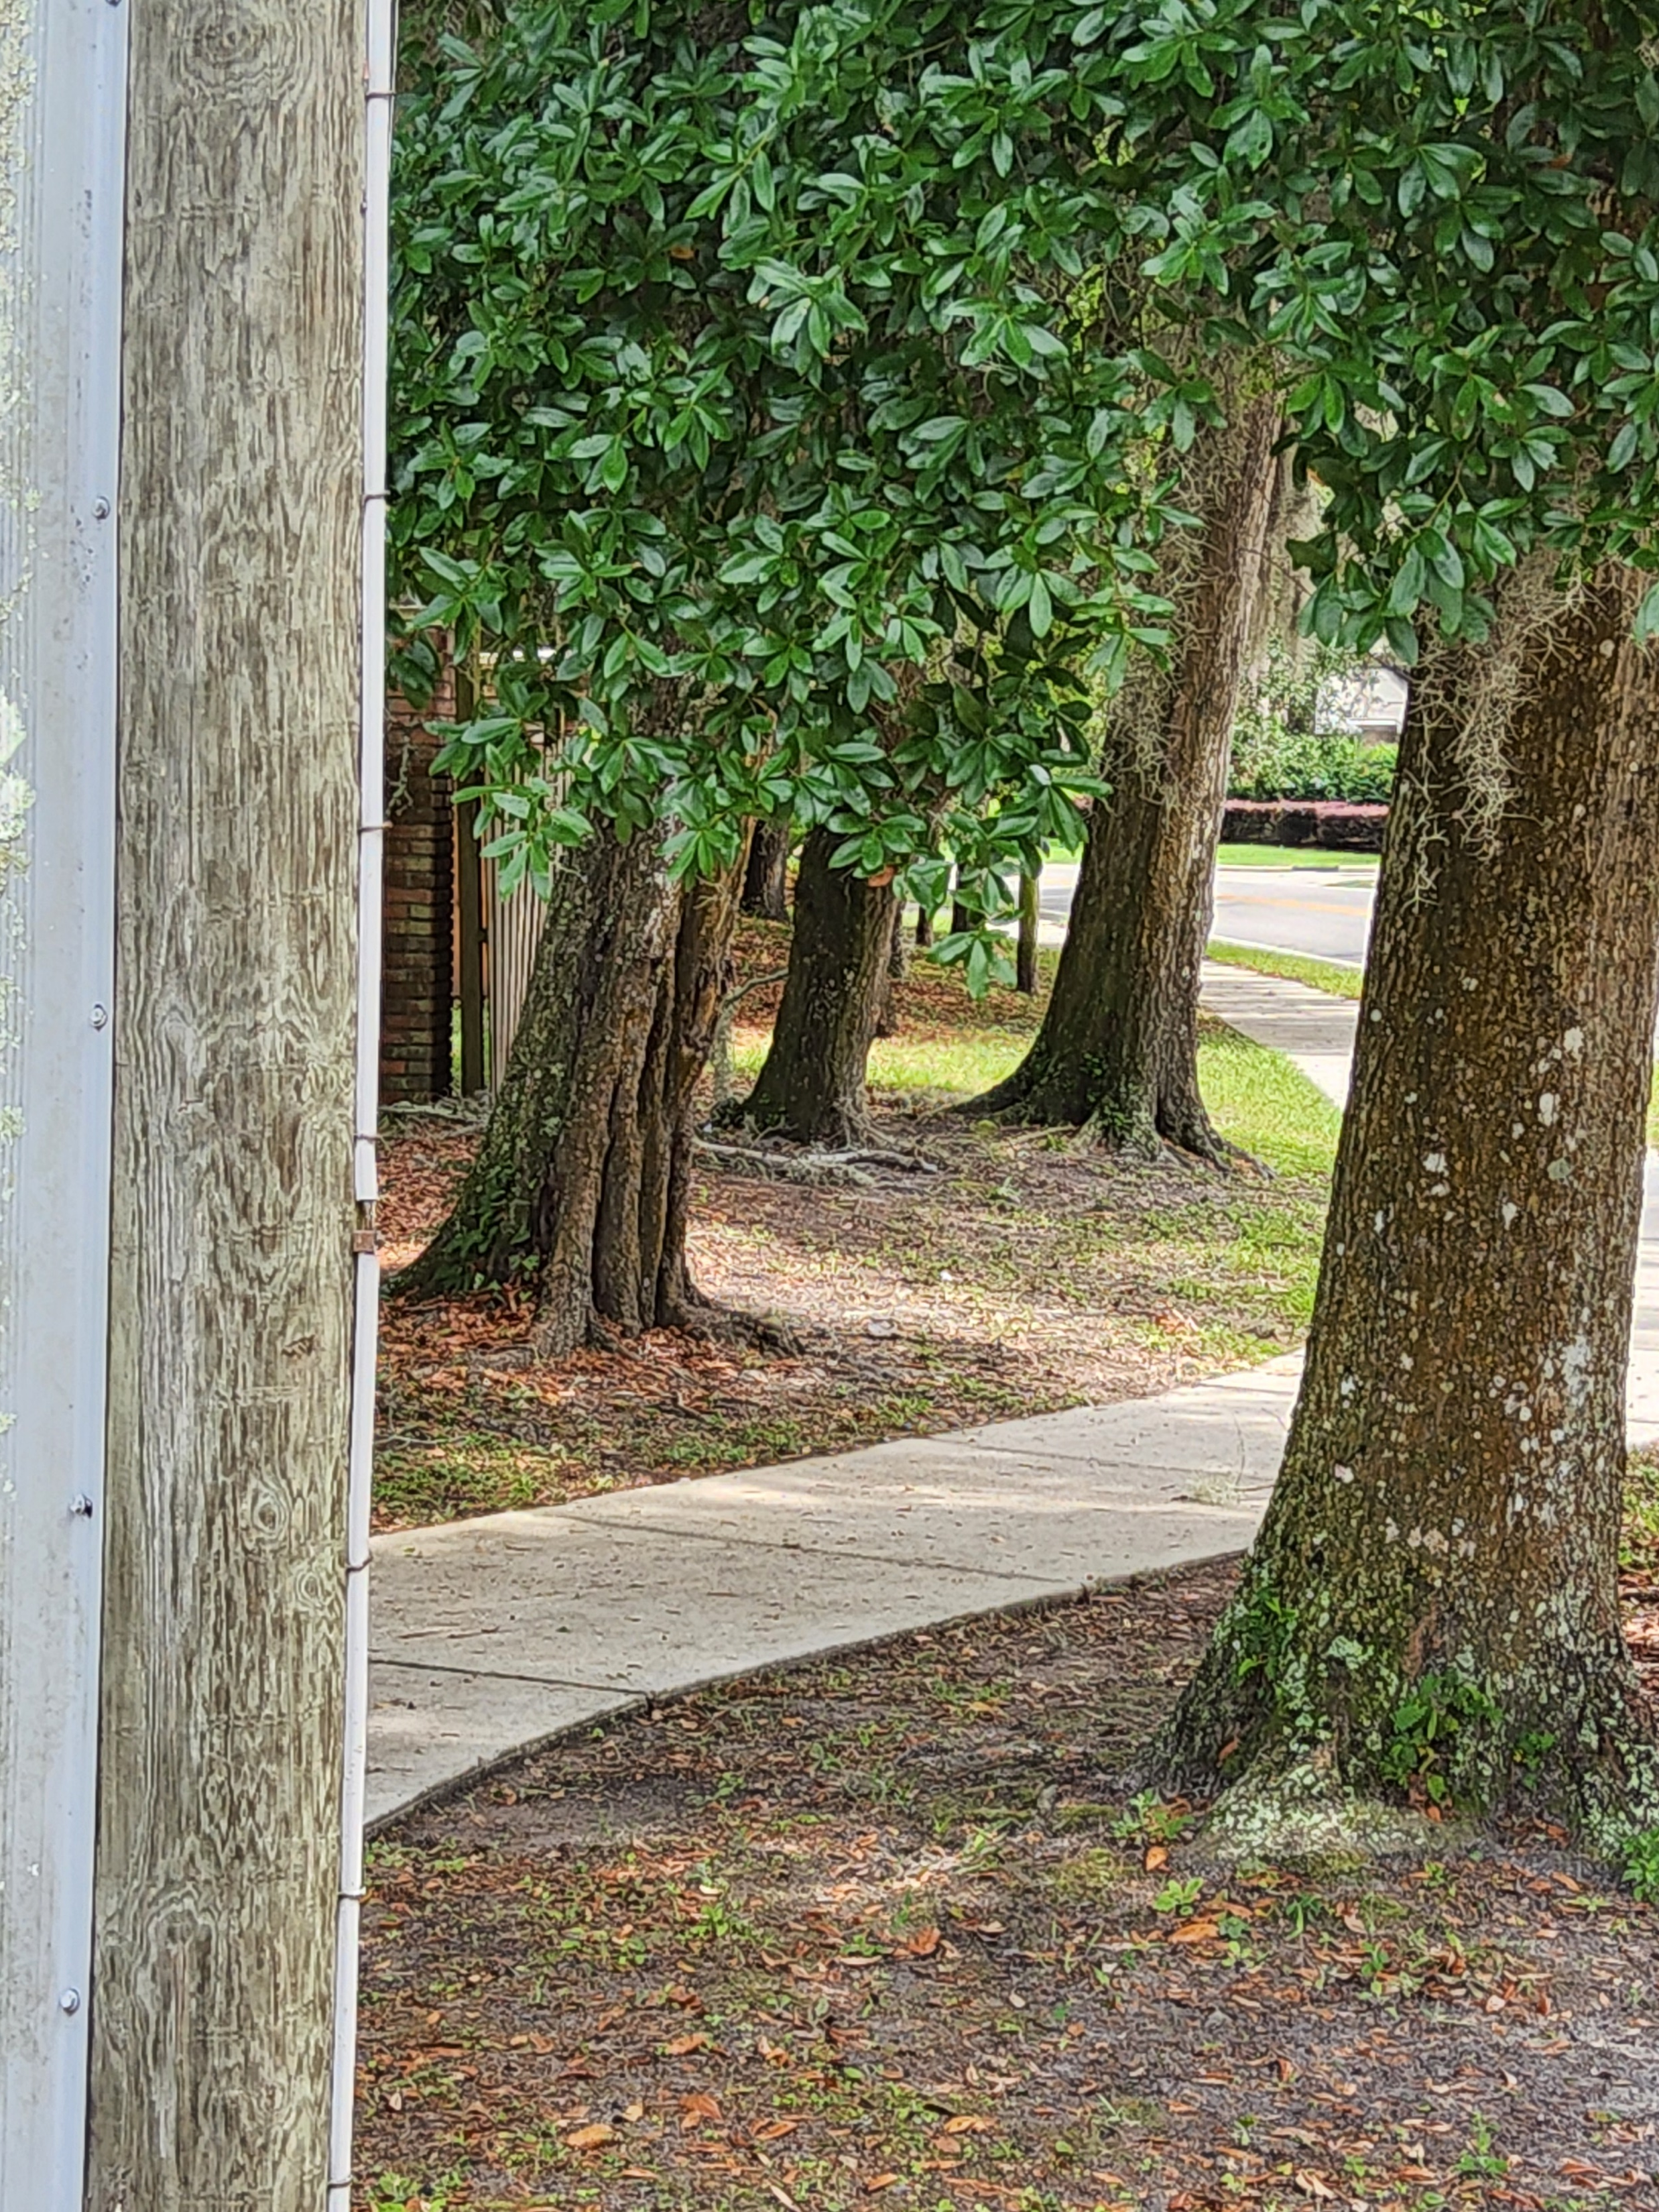
MINGE ROAD
RED CYPRESS DRIVE

Slide 15
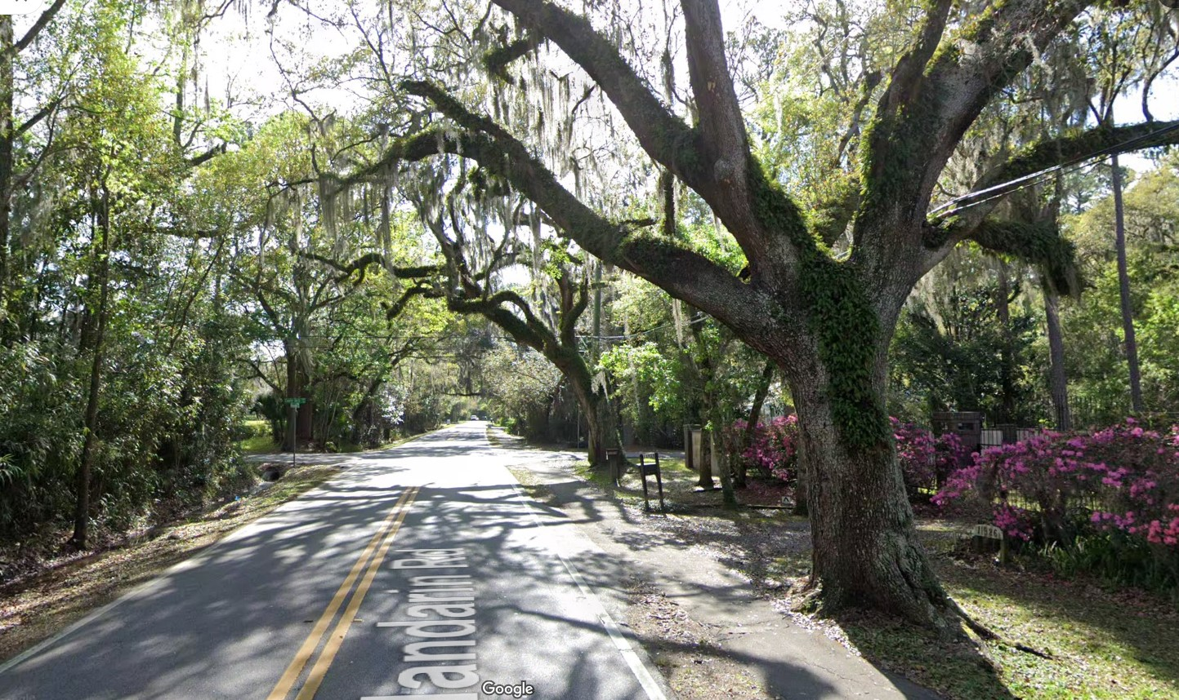
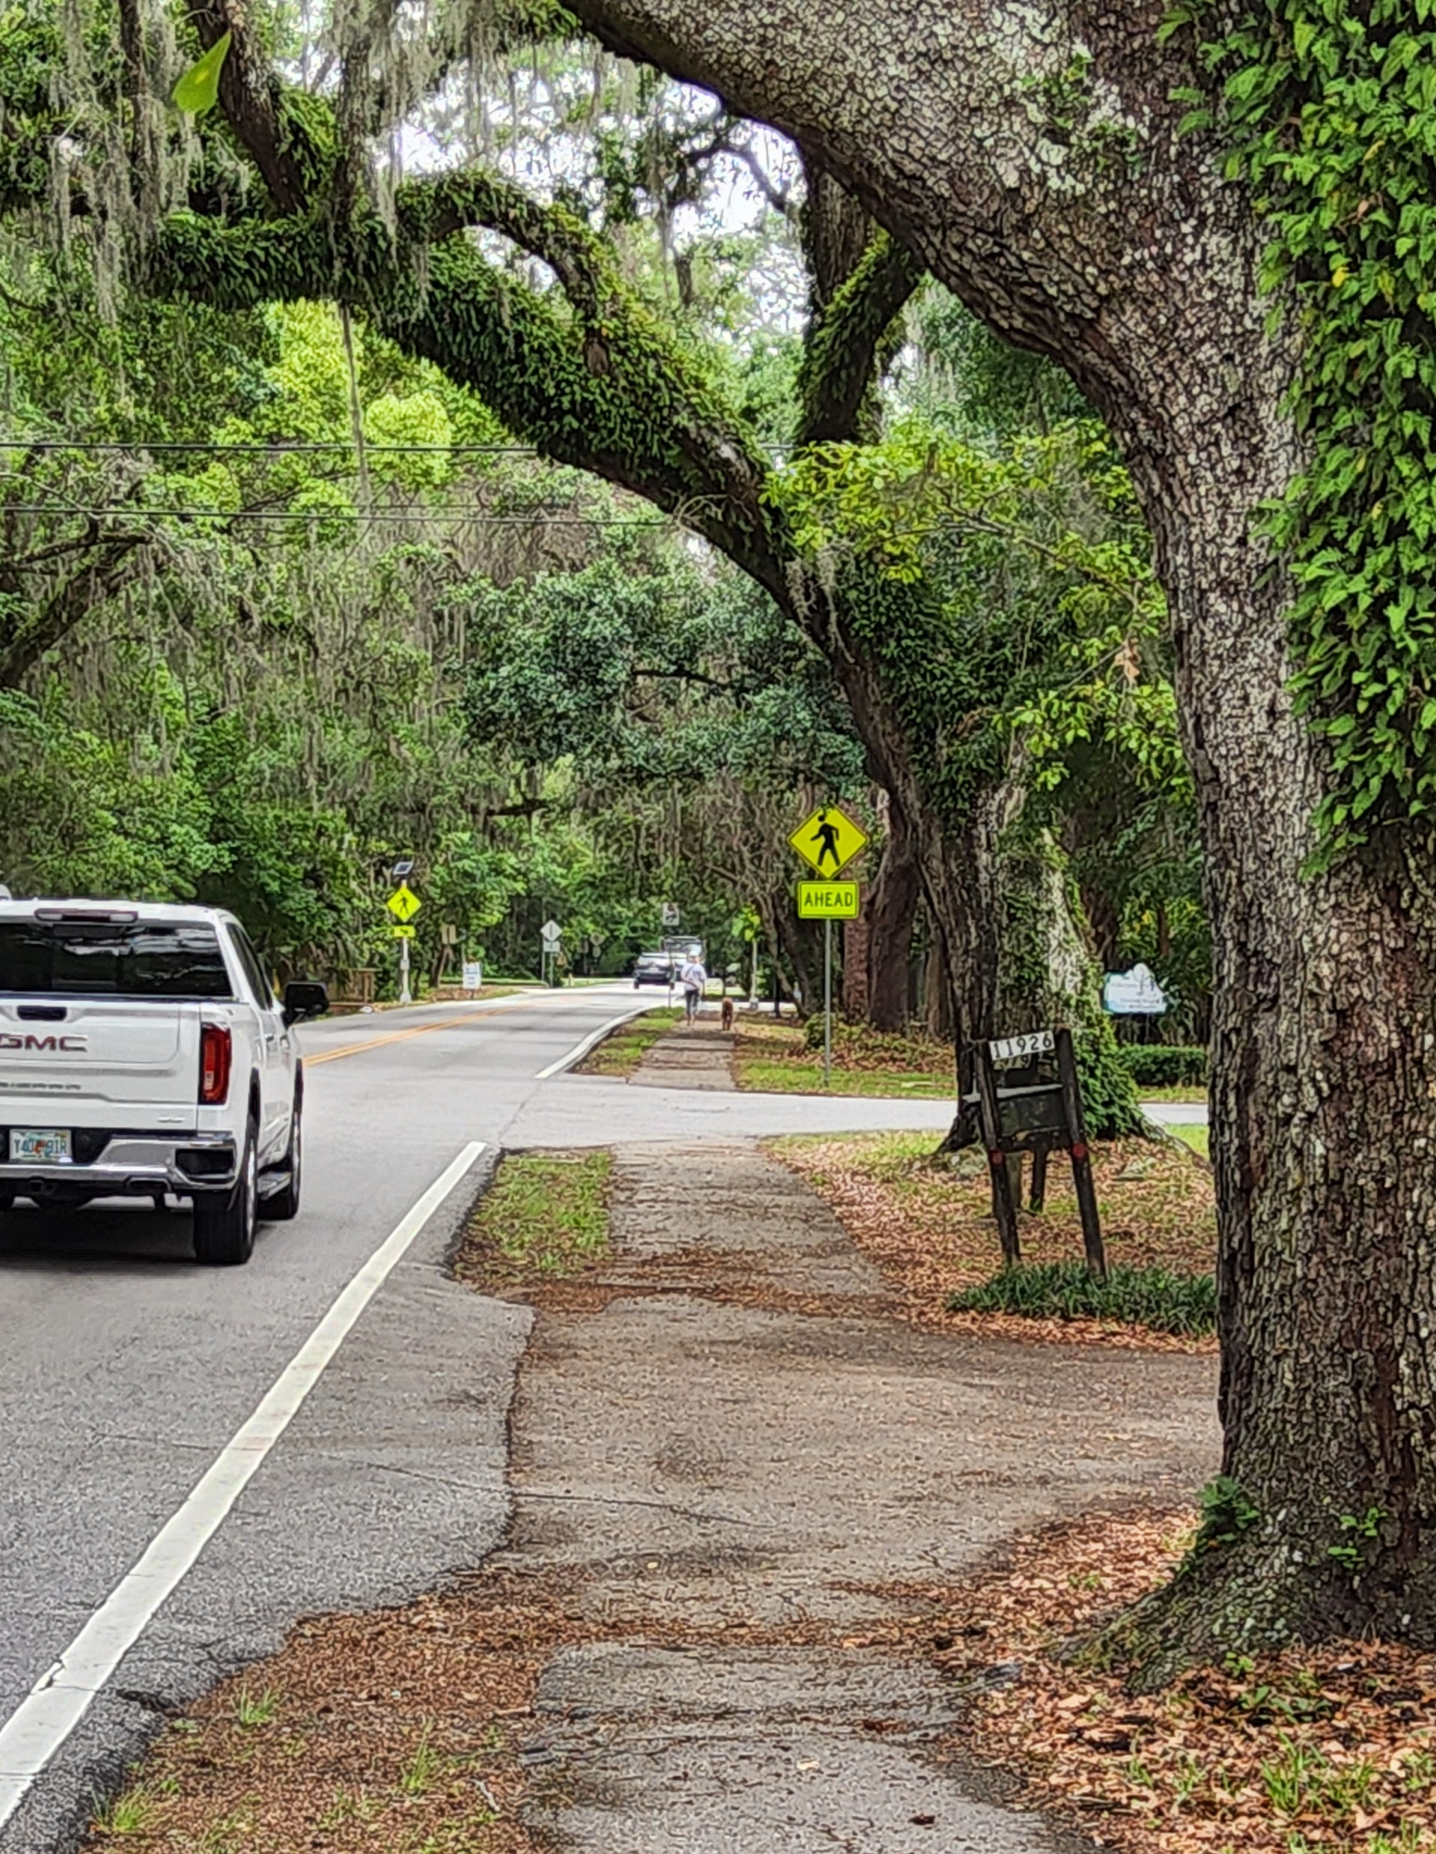
COUNTY DOCK ROAD

Slide 16

JOHNATHAN COLBURN
Board Certified Master Arborist
Urban Forest Manager
City of Jacksonville

